Slide 1

MNIST dataset using SVM with Kernel and without Kernel and Comparing with Logistic Regression
FLAMINGO
Presented By:
DHANUSH SURESH - P37000046
ABHISHEK BARANDOORU JANAVEJIRAO - P37000047
KAVYA ENDLA - P37000053

Slide 2

INTRODUCTION
To demonstrate by predicting the best model
MNIST dataset is used in the project
Support Vector Machine
Logistic Regression
Python Programming

Slide 3
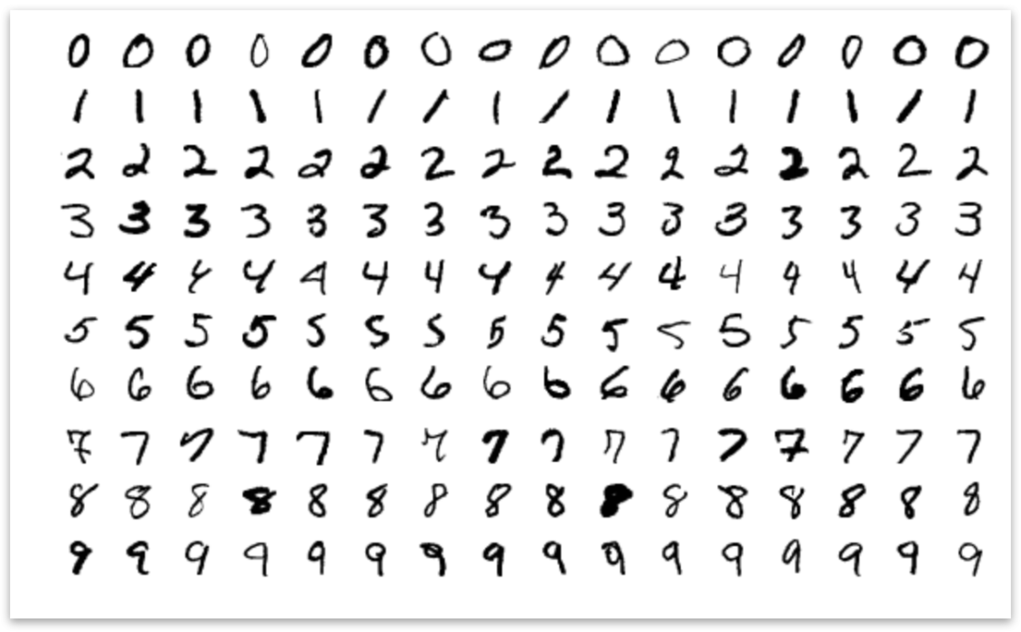
What is MNIST DATA ?
Modified National Institute of Standards and Technology dataset ( MNIST)
Handwritten digit recognition
70,000 dataset (Images)
Flatten this array into a vector of 28 * 28 = 784 Pixels

Slide 4
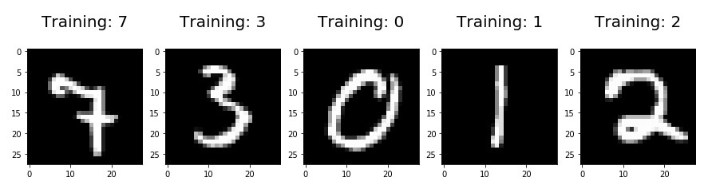
Goal
Import the Datasets
Train a Model
Look at Images
Predict what digits they are.
Each MNIST data point has 2 parts
Image of Hand written digit
Corresponding label
Permutation randomly

Slide 5
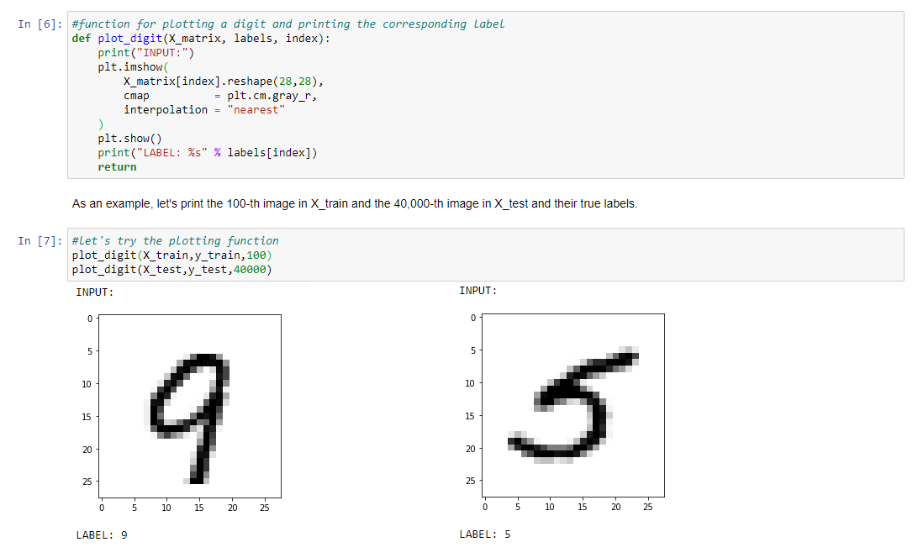

Slide 6
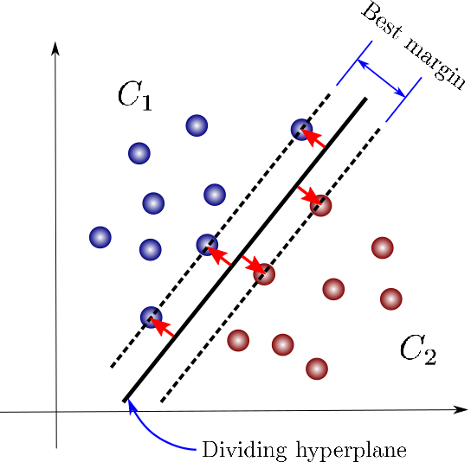
Support Vector Machine
Objective
Is to identify an optimal separating hyperplane which maximizes the margin between different classes of the training data
Without Kernels i.e Linear SVM
With Kernels
Polynomial
RBF
Support Vector
Hyper Plane
Marginal Distance

Slide 7
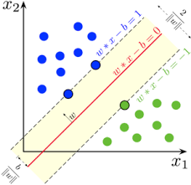
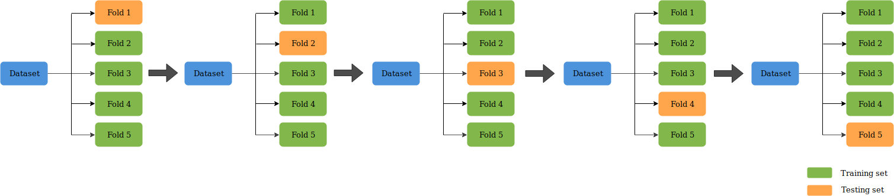
Linear SVM
Solving multiclass classification problems from large data sets
What is K-Fold Cross Validation?

Slide 8
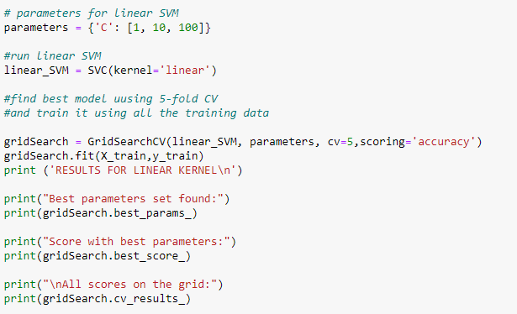
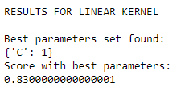

Slide 9
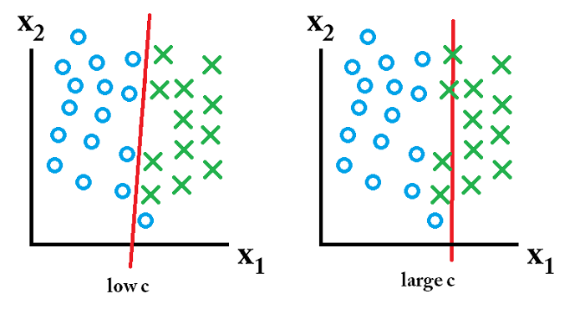
C Parameter
C- It is a hypermeter in SVM to control error
Low c means Low error
large c means high error

Slide 10
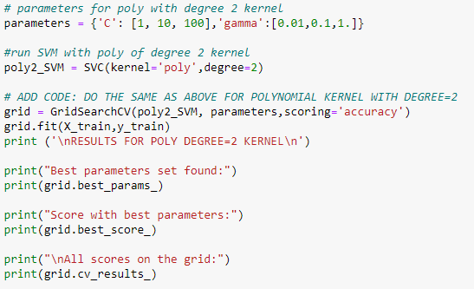
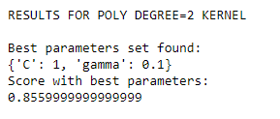
Polynomial SVM
For degree-d polynomials
K(x,y) = (xTy + c)^d

Slide 11
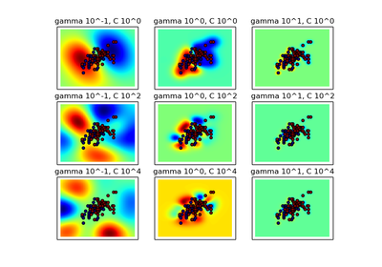
Gamma
Gamma is used when we use the Gaussian RBF kernel

Slide 12
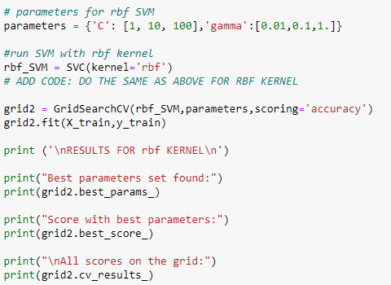
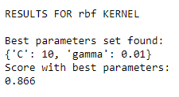
Radial Basis Function Kernel (RBF)
Accuracy
Parameters gamma and C of the Radial Basis Function (RBF) kernel SVM.

Slide 13
Comparing the accuracy within svm
Without Kernel i.e, Linear SVM
83%
With Kernel Polynomial SVM
85.59%
With Kernel RBF SVM
86.6%

Slide 14
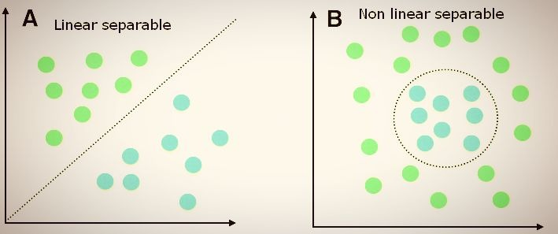
Logistic regression
Like all regression analyses, logistic regression is a predictive analysis
Linear Separable
Non Linear Separable

Slide 15
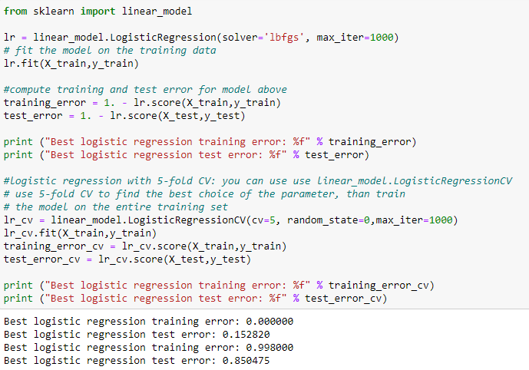

Slide 16
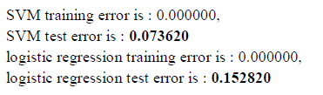
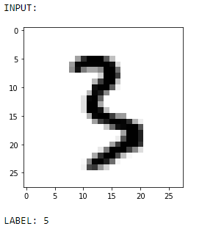
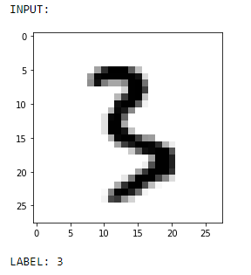
Compare Logistic Regression with SVM
SVM is the best
To Over Come the ERROR in Logistic Regression

Slide 17
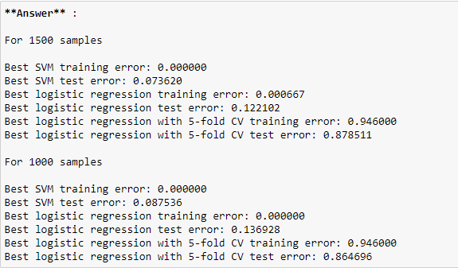
For More Datasets

Slide 18

Conclusion
Linear SVM
SVM
Polynomial SVM
MNIST Dataset
RBF SVM
Logistic Regression
Based on this project we proved that SVM (RBF) is more accuracy

Slide 19


FLAMINGO
Thank You.....

